Slide 1
Domains of computer science
Course Code: CSC 11011
Course Title: Introduction to Computer Studies
Dept. of Computer Science
Faculty of Science and Technology
Lecturer No: | 5 | Week No: | 5 | Semester:
Lecturer: | Name & email

Slide 2
Lecture Outline
Different domains of Computer Science
Opportunities
Chapter-5,6, IT Essentials
AIUB Grading structure

Slide 3
Specific Objectives
Exploring knowledge and opportunity of different domains of Computer Science.
Understanding about AIUB grading structure and calculation.
Discussion about Exam Permit policies during and before exam.

Slide 4
Domains
Data science
Computer Architecture and High Performance Computing
Computer Networks and Security
Databases
Algorithm Development
Web Development
Mobile Development
IOT

Slide 5
Data Science
Image Processing – medical diagnosis, image editor
Machine Learning – e.g Search Engine Result Refining, Product Recommendations, Online Fraud Detection
Big data handling – e.g weather forecasting, Getting insights from customer reviews
Artificial Intelligence – e.g Flying Drones, siri, tesla etc
Deep Learning – e.g. Automated Driving,
Data Mining-Card fraud detection, medical diagnosis
Bio-Informatics - Gene therapy, Drug development

Slide 6
High Performance Computing
Distributed Computing
Cloud Computing
Parallel Computing

Slide 7
Computer Networks
Web Development
IoT
Android Development
Security – steganography , information security etc

Slide 8
Opportunities
Software Developer
IT consultant
Cyber security consultant
Information systems manager
Database administrator
Multimedia programmer
Systems analyst
Games developer
Forensic computer analyst
Data analyst
UX designer
Web designer
Web developer
E-Commerce Analyst
Network Security Engineer
And many more…

Slide 9
IT Essentials
Chapter 5,6
The module is available on CISCO account.

Slide 10
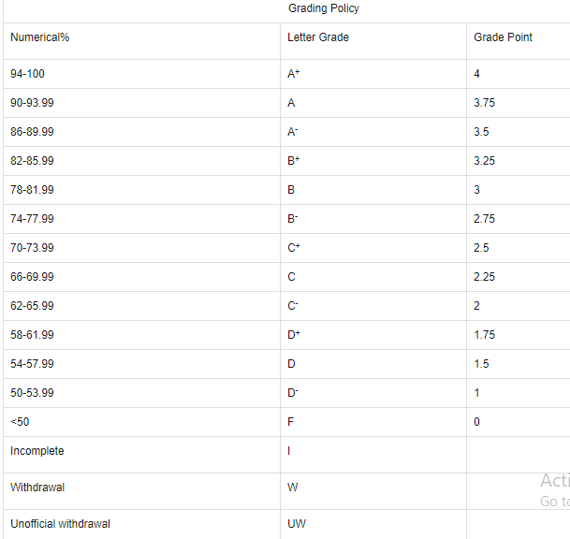
Grading Policy
Here is the link where all the detailed
Information about grading structure will be
found-
Link:
https://www.aiub.edu/academics/regulations

Slide 11
Exam Permit Policy
A student will not be allowed to seat in the examination without the permit
A student will only get his/her permit if all the things(payment, required attendance, etc.) are cleared against the student.
Student must collect the permit from the VUES.
Student need to bring the permit in every exam. In lost or any other case student can collect temporary permit from the VUES. But in that case condition should be meet up for the eligibility.

Slide 12
References
https://intellipaat.com/blog/7-big-data-examples-application-of-big-data-in-real-life/
https://www.computersciencezone.org/50-highest-paying-jobs-computer-science/
https://insights.daffodilsw.com/blog/9-machine-learning-examples-from-day-to-day-life
https://www.iqvis.com/blog/9-powerful-examples-of-artificial-intelligence-in-use-today/
https://www.thebalancecareers.com/top-jobs-for-computer-science-majors-2059634

